Slide 1
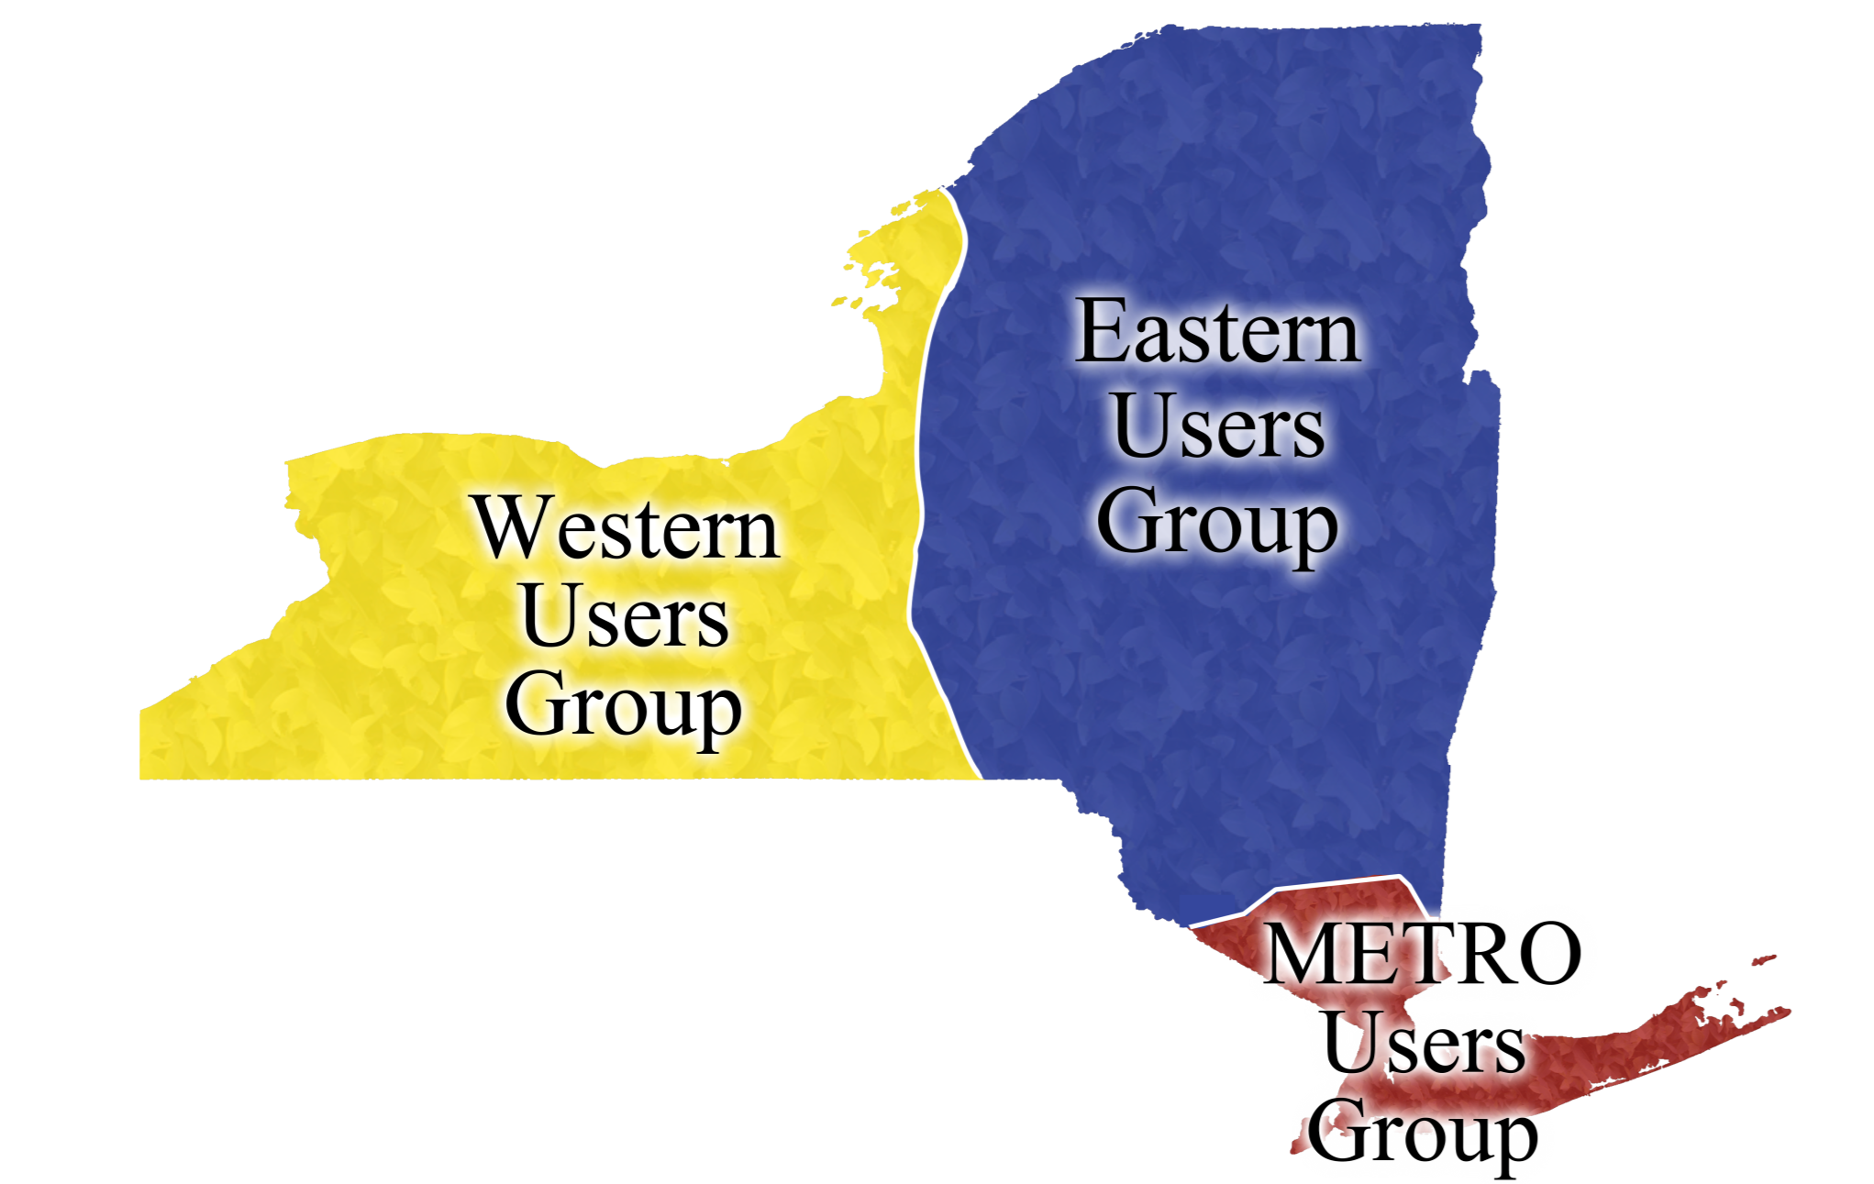
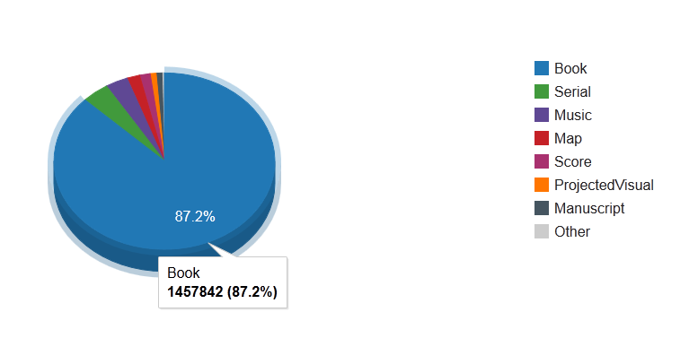
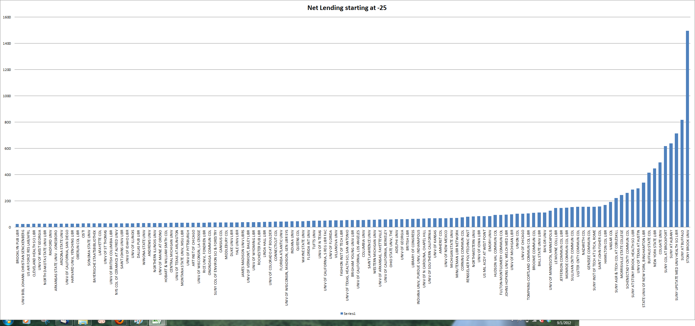
Regional User Groups: ILL/DD Statistics

Slide 2
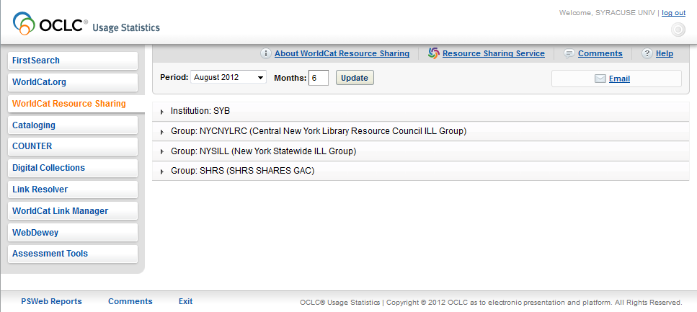
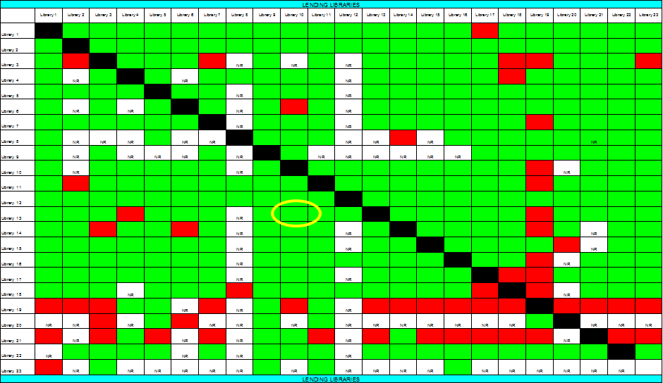
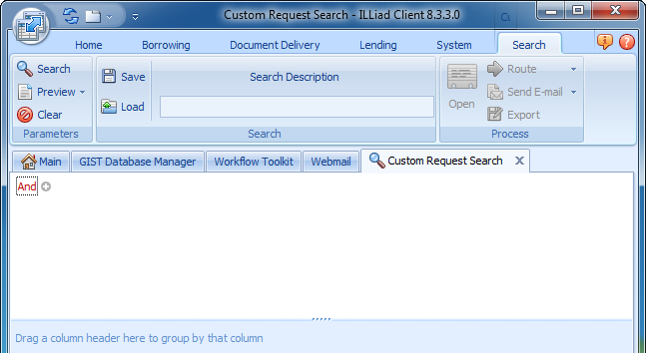
What tools are available?
Usage Statistics
ILLiad Web Reports
TPAM
ILLiad Custom Search
Access Database

Slide 3
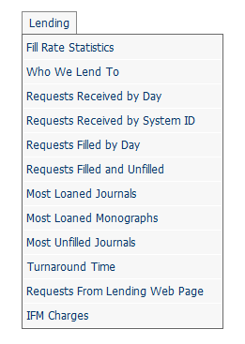
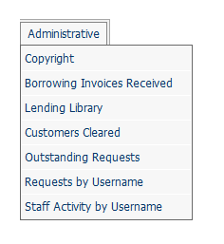
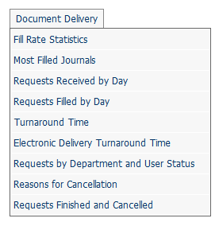
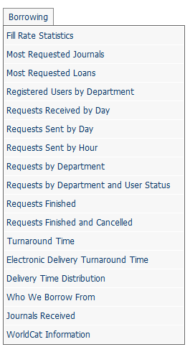
Overview of ILLiad Web Reports
Click here for information on accessing your Web Reports

Slide 4
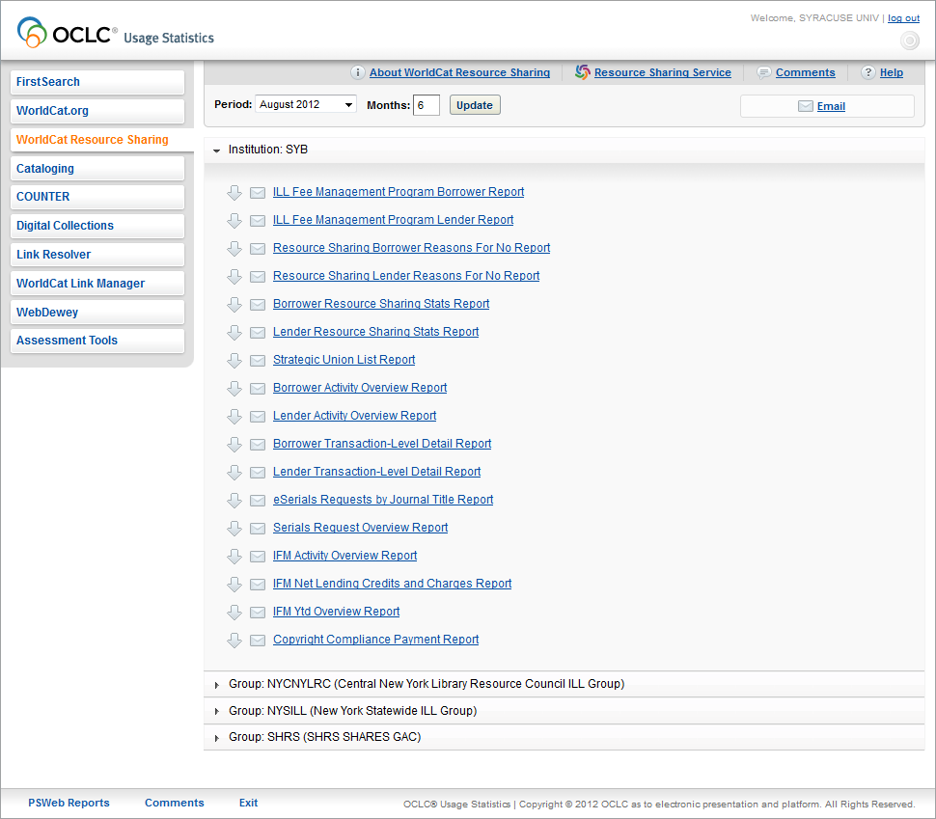
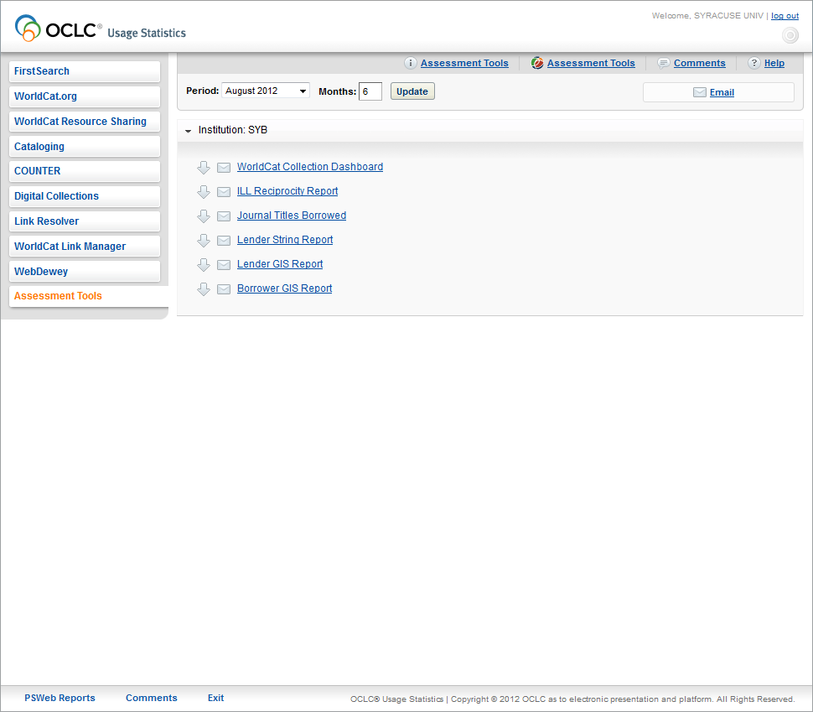
Overview of OCLC Usage Statistics

Slide 5
ILLiad/Access (best for transaction information at request level) | OCLC (best for life of transaction) | TPAM (best for life of transaction) | Data
 | x | x | Entire transaction for lending books
X – Best/easiest | X | X | Articles Sent
X | X | X – Easiest to understand | Evaluation of lender performance
X |  |  | Requests received/sent by day
X – based on when it leaves your library | X – patron centered definition | X – patron centered definition (easier to read) | Turnaround time
X – counts each title | X – gives list without count |  | Journals titles borrowed
X |  | X | Detailed info about workflow performance

Slide 6
Why Use Access
Deeper analysis of data
Automatically updated queries
Set something up once and you’ll be good to go.
Relative Criteria (one year ago, last three months)
Run analysis of large data sets (can analyze years of data). No more failed exports!
Save complex queries for further analysis

Slide 7
Warning: Advanced Users Only
Access is included here just to give you an idea of what’s possible.
Unless you’re intimately familiar with SQL and/or building Access queries, either find a friend or book.

Slide 8
More information online
A stand-alone Access presentation is available on the IDS Project website.
That presentation could be given to a systems person and they could work with you to configure and use Access.

Slide 9
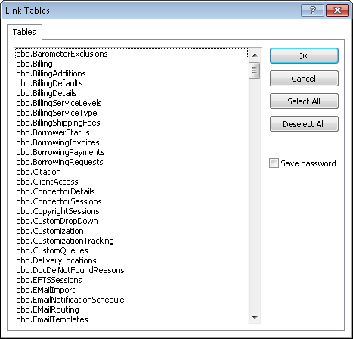
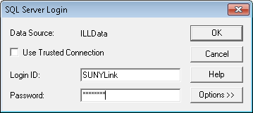
Starting Out with Access
Step 1: Log into the database (after setup).
Step 2: Pick the tables to link
You’ll see every table in the Customization Manager. Only the dbo_ tables are important.
dbo_Transactions
dbo_Users (etc)

Slide 10
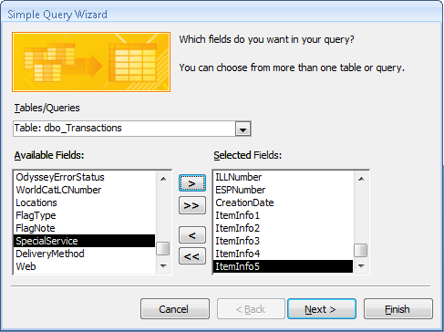
Creating Queries
On the Create menu, choose Query Wizard.
Add the fields you want to see in the end report, and any fields you want to operate against.

Slide 11
Example Query: Copyright Compliance Queue
Step 1: Query for all Articles Borrowed for the last calendar year.
Criteria:
ProcessType is "Borrowing"
CopyrightAlreadyPaid is "No"
CreationDate is Between #1/1/2011# And #12/31/2011#
PhotoJournalYear > Year(Date()-"5")

Slide 12
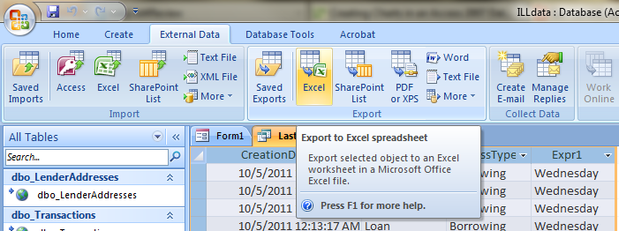
Export to Excel
Charts don’t work well with Linked Data. ☹
Under External Data, Export to Excel

Slide 13
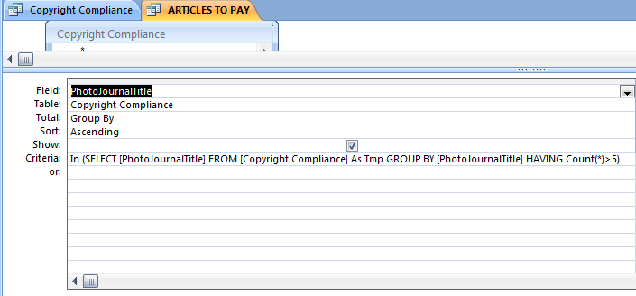
But which ones do we have to pay?
We need to query a query:
Create another query to sort through Copyright Compliance queue (I named mine Articles to Pay).
This query has a subquery.
Notes:
In (SELECT [PhotoJournalTitle] FROM [Copyright Compliance] As Tmp GROUP BY [PhotoJournalTitle] HAVING Count(*)>5)

Slide 14
Do I have to use Access?
NO!
ILLiad custom searching is amazing.
Together with Excel, it’s usually enough.
Stay tuned for more on custom searching!

Slide 15
Feature of Using an Illiad Web Report with Excel to get useful data for staffing decisions:
Requests Received by Day
Requests Sent by Day

Slide 16
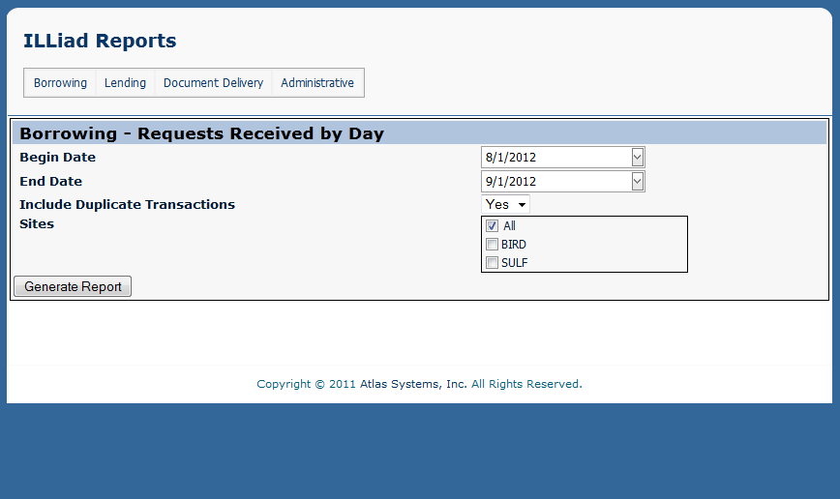
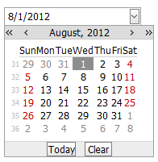
Selecting the Date Range

Slide 17
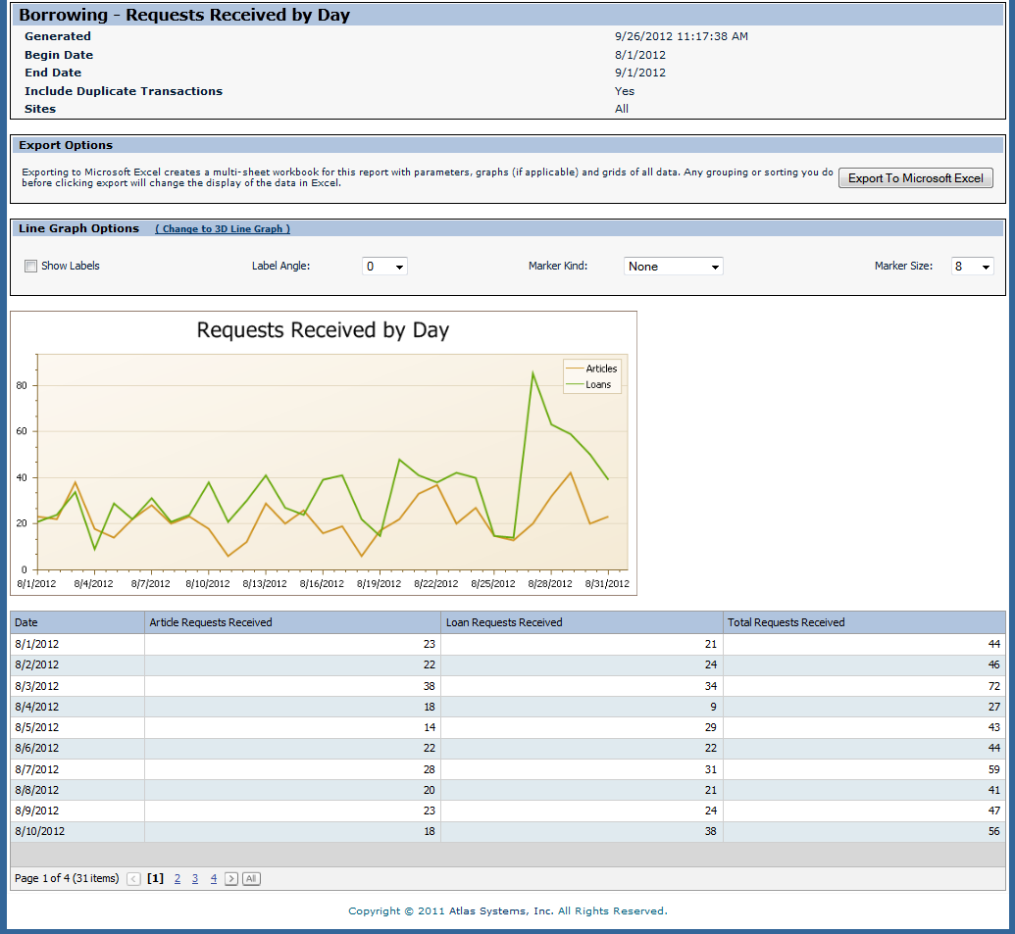
Shows a spike during the beginning of the Fall semester
This shows the dates, but not an average for each week day.

Slide 18
We want to find out what days of the week that we need the most staffing.
We can find this out by exporting the report to Excel and converting the date into a weekday.

Slide 19
But how do we convert the date into a weekday?!?

Slide 20
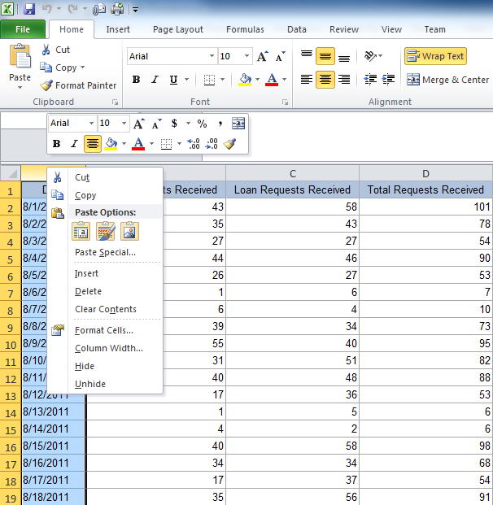
You can do this by using the following formula:
=text(B2, “dddd”)
First we will need to create a place to put this formula.
Right click on Column A and click on “Insert”. Alternatively you can right clicking on Column A and press the “i” key.

Slide 21
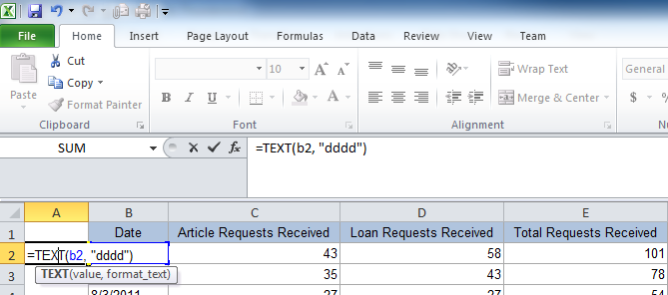
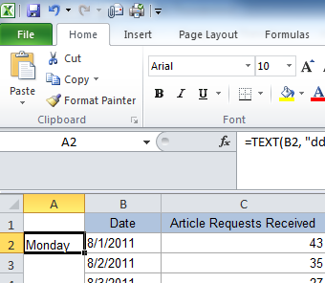
Using the =text(B2, “dddd”) formula
Click in Cell A2 and enter the formula:
=text(B2, “dddd”)
“B2” in the formula represents the date in cell B2.
Hover your mouse over the small square at the bottom right corner of the selected cell. This will change your pointer into a crosshair. Click and drag the crosshair all the way down the sheet until you reach the last date.

Slide 22
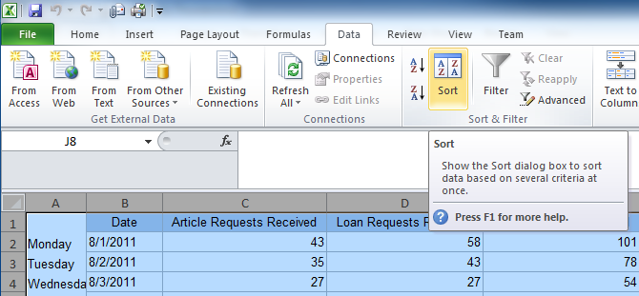
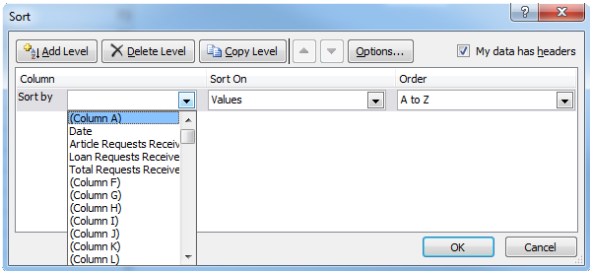
Sorting the days of the week
Hold the “Ctrl” button and press the “A” key to select all of your data.
Click on “Data” in the ribbon, and then select “Sort”
This window will appear. Make sure that “My data has headers” is selected. Click the down arrow from “Sort by” and select “(Column A)”. Click the OK button.

Slide 23
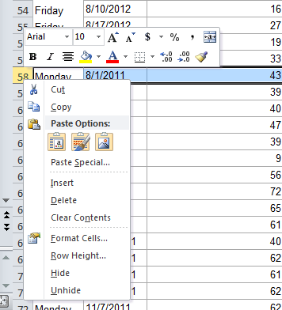
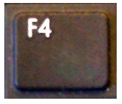
Sorting the days of the week
The data will now be sorted by week day name, but the days of the week will not be in order. We need to break apart each data set for each weekday.
Scroll down the spreadsheet until you reach “Monday”. Right click on the row number to the left of “Monday” and click on “Insert” or press the “i” key on your keyboard.
This will create one row of space. You will need to insert a few more cells to make some extra space. A shortcut to repeat the last action in Excel is the:
Key
Repeat this process until you have divided all of the weekday sets.

Slide 24
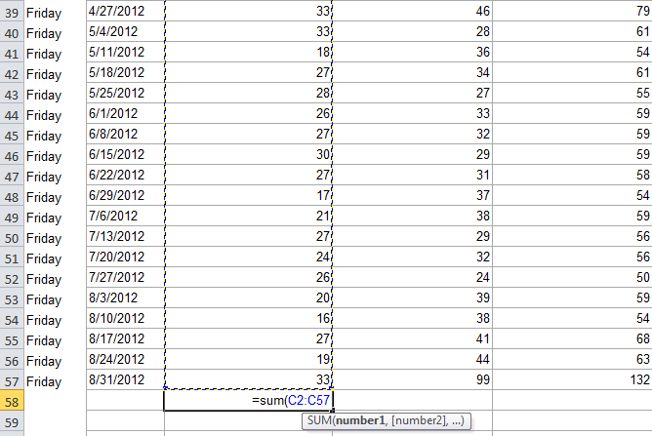
Creating a sum for each column
Click in the cell under the last number in Column C for Friday, the click on the AutoSum function under “Formulas” in the Ribbon, then press Enter.
Your formula should look something like:
=sum(C2:C57)
Expand the formula to the other columns by using the small square at the bottom right of the selected sum cell. Click and drag this square to the right using the crosshair. Type the weekday label for the sums.
Repeat for each weekday

Slide 25
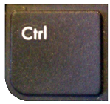
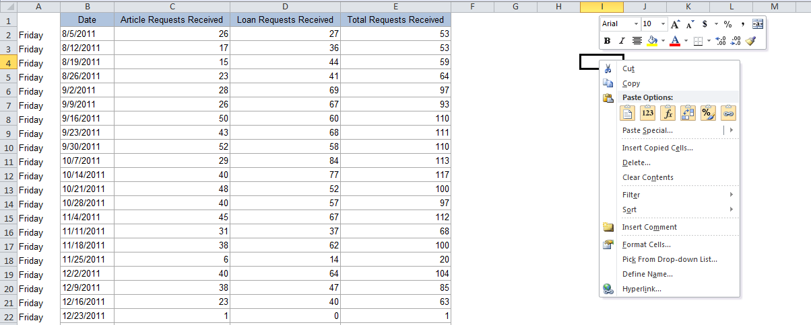
Copying in the sums for your chart
Starting with the day, highlight the sums and copy them. Use:
+
to copy
Scroll up to the top of your spreadsheet and right-click on any cell to the right of the data.
Choose:

Slide 26
You should now have something that looks like this:
Add headers to your new data by copying and pasting the original headers
1. Highlight headings 2. Ctrl + C to copy 3. Ctrl + V to paste

Slide 27
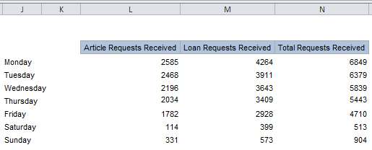
You’ll notice that the heading is squished together. Move your mouse cursor in between the two columns until the cursor transforms into this shape:
Now double-click to expand the column.
Do this for each squished heading.
Continue adding each weekday data set. Once you are finished, manually sort the data by copying and pasting each weekday set in order.
You could also plan ahead and paste the weekdays in order, one by one, as you go.

Slide 28
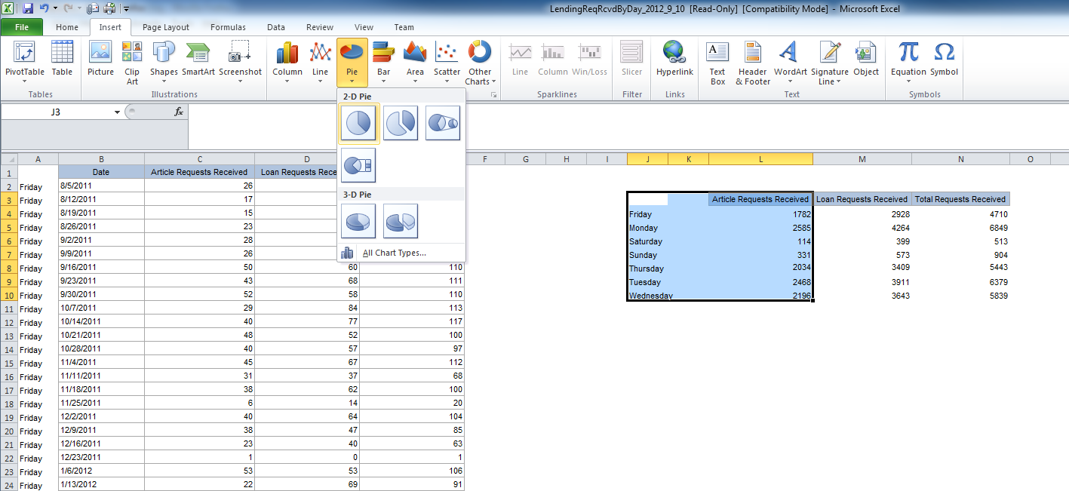
Create a pie chart for your data
2
3
4
1
1
Highlight the weekdays and the first set of numbers
2
Click “Insert” on the Ribbon
3
Click on “Pie” for the dropdown menu
4
Click on the flat 2-D Pie

Slide 29
You should now have a chart that looks like this:
The colors look great, but where are the numbers?

Slide 30
Adding data to your pie chart
2
3
1
To add % to the pie chart:
1
Click on the pie chart
2
Click on “Chart Tools” (shown in green)
3
Click on the pie chart with % signs

Slide 31
Create additional pie charts for your data
1
Click on the pie chart that is already created
2
Hold the Control button and press “C”
3
Click anywhere on the spreadsheet
4
Hold the Control button and press “V” (creates duplicate chart)
5
Click on the new chart, and in your data chart, click and drag the green box to the new title and click and drag the blue box to the new data

Slide 32
The pie chart is useful to get an overall sense of how requests are distributed for each day, but it would be better to know exactly how much is being requested and processed each day.
Creating bar graphs follows the same procedures listed above

Slide 33
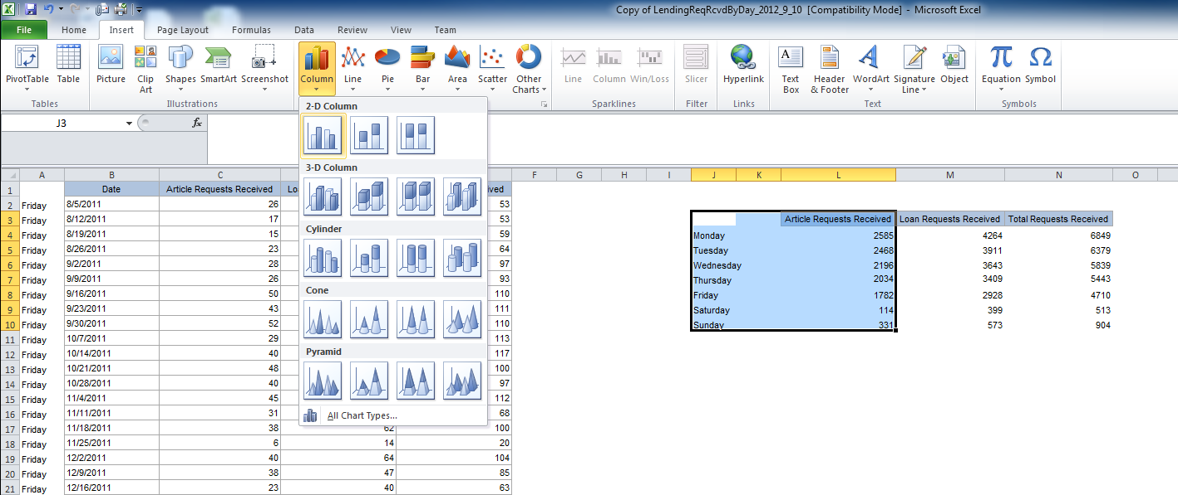
2
3
4
1
1
Highlight the weekdays and the first set of numbers
2
Click “Insert” on the Ribbon
3
Click on “Column” for the dropdown menu
4
Click on the flat 2-D Column

Slide 34
You should now have a chart that looks like this:
Question: What am I missing on this chart?

Slide 35
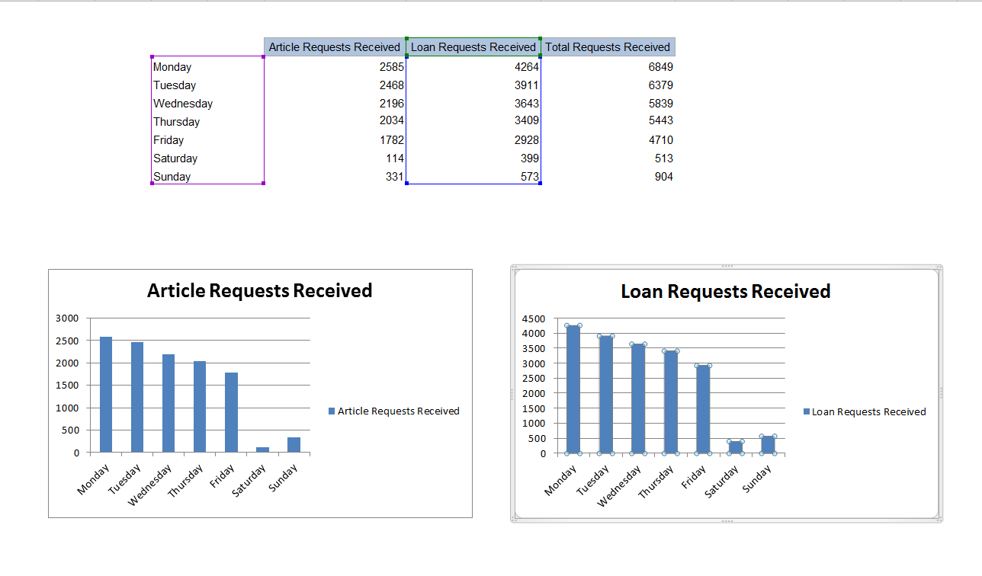
Create additional bar graphs for your data
1
Click on the bar graph that is already created
2
Hold the Control button and press “C”
3
Click anywhere on the spreadsheet
4
Hold the Control button and press “V” (creates duplicate chart)
5
Click on the new chart, and in your data chart, click and drag the green box to the new title and click and drag the blue box to the new data

Slide 36
It would be useful to compare the requests of Saturday and Sunday to find if it would be beneficial to having someone staffing ILL on Saturday and/or Sunday, or if the requests could wait until Monday.
Lending Requests Received (Aug 2011 – Dec 2011)
 | Article Requests | Loan Requests | Total
8/6/2011 | 1 | 6 | 7
8/13/2011 | 1 | 5 | 6
8/20/2011 | 1 | 2 | 3
8/27/2011 | 0 | 3 | 3
9/3/2011 | 1 | 13 | 14
9/10/2011 | 5 | 7 | 12
9/17/2011 | 4 | 11 | 15
9/24/2011 | 2 | 5 | 7
10/1/2011 | 2 | 9 | 11
10/8/2011 | 5 | 3 | 8
10/15/2011 | 4 | 8 | 12
10/22/2011 | 0 | 13 | 13
10/29/2011 | 1 | 4 | 5
11/5/2011 | 2 | 11 | 13
11/12/2011 | 2 | 12 | 14
11/19/2011 | 0 | 11 | 11
11/26/2011 | 2 | 8 | 10
12/3/2011 | 10 | 4 | 14
12/10/2011 | 1 | 7 | 8
 | Article Requests | Loan Requests | Total
8/7/2011 | 6 | 4 | 10
8/14/2011 | 4 | 2 | 6
8/21/2011 | 2 | 6 | 8
8/28/2011 | 1 | 8 | 9
9/4/2011 | 2 | 10 | 12
9/11/2011 | 22 | 29 | 51
9/18/2011 | 7 | 17 | 24
9/25/2011 | 10 | 8 | 18
10/2/2011 | 3 | 15 | 18
10/9/2011 | 9 | 16 | 25
10/16/2011 | 14 | 27 | 41
10/23/2011 | 12 | 21 | 33
10/30/2011 | 15 | 16 | 31
11/6/2011 | 9 | 16 | 25
11/13/2011 | 6 | 14 | 20
11/20/2011 | 3 | 12 | 15
11/27/2011 | 12 | 13 | 25
12/4/2011 | 10 | 9 | 19
12/11/2011 | 6 | 5 | 11
 | Article Requests | Loan Requests | Total | Added from weekend
8/8/2011 | 39 | 34 | 73 | +17
8/15/2011 | 40 | 58 | 98 | +12
8/22/2011 | 47 | 70 | 117 | +11
8/29/2011 | 39 | 69 | 108 | +12
9/5/2011 | 9 | 14 | 23 | +26
9/12/2011 | 56 | 86 | 142 | +63
9/19/2011 | 72 | 90 | 162 | +39
9/26/2011 | 65 | 131 | 196 | +25
10/3/2011 | 61 | 119 | 180 | +29
10/10/2011 | 40 | 55 | 95 | +33
10/17/2011 | 62 | 90 | 152 | +53
10/24/2011 | 61 | 86 | 147 | +46
10/31/2011 | 62 | 80 | 142 | +36
11/7/2011 | 62 | 99 | 161 | +38
11/14/2011 | 78 | 135 | 213 | +34
11/21/2011 | 60 | 93 | 153 | +26
11/28/2011 | 79 | 122 | 201 | +35
12/5/2011 | 54 | 73 | 127 | +33
12/12/2011 | 37 | 55 | 92 | +19
Saturday
Sunday
Monday
Question: Should SYB staff on Sunday?

Slide 37
Now let’s look at the borrowing requests data
Borrowing Requests Received (Aug 2011 – Dec 2011)
 | Article Requests | Loan Requests | Total Requests
8/6/2011 | 5 | 15 | 20
8/13/2011 | 4 | 10 | 14
8/20/2011 | 15 | 15 | 30
8/27/2011 | 5 | 25 | 30
9/3/2011 | 5 | 14 | 19
9/10/2011 | 7 | 44 | 51
9/17/2011 | 23 | 15 | 38
9/24/2011 | 32 | 28 | 60
10/1/2011 | 22 | 25 | 47
10/8/2011 | 5 | 20 | 25
10/15/2011 | 19 | 53 | 72
10/22/2011 | 8 | 37 | 45
10/29/2011 | 12 | 31 | 43
11/5/2011 | 8 | 40 | 48
11/12/2011 | 12 | 24 | 36
11/19/2011 | 16 | 23 | 39
11/26/2011 | 22 | 22 | 44
12/3/2011 | 41 | 20 | 61
12/10/2011 | 15 | 28 | 43
 | Article Requests | Loan Requests | Total Requests
8/7/2011 | 6 | 1 | 7
8/14/2011 | 10 | 14 | 24
8/21/2011 | 20 | 22 | 42
8/28/2011 | 6 | 27 | 33
9/4/2011 | 8 | 31 | 39
9/11/2011 | 10 | 24 | 34
9/18/2011 | 27 | 14 | 41
9/25/2011 | 25 | 25 | 50
10/2/2011 | 21 | 33 | 54
10/9/2011 | 3 | 30 | 33
10/16/2011 | 27 | 51 | 78
10/23/2011 | 17 | 39 | 56
10/30/2011 | 8 | 31 | 39
11/6/2011 | 26 | 30 | 56
11/13/2011 | 24 | 25 | 49
11/20/2011 | 15 | 18 | 33
11/27/2011 | 9 | 9 | 18
12/4/2011 | 20 | 32 | 52
12/11/2011 | 4 | 20 | 24
 | Article Requests | Loan Requests | Total Requests | Added from weekend
8/8/2011 | 20 | 34 | 54 | +27
8/15/2011 | 12 | 29 | 41 | +38
8/22/2011 | 15 | 26 | 41 | +72
8/29/2011 | 10 | 74 | 84 | +63
9/5/2011 | 13 | 28 | 41 | +58
9/12/2011 | 16 | 60 | 76 | +85
9/19/2011 | 38 | 19 | 57 | +79
9/26/2011 | 47 | 26 | 73 | +110
10/3/2011 | 60 | 53 | 113 | +101
10/10/2011 | 31 | 38 | 69 | +58
10/17/2011 | 29 | 35 | 64 | +150
10/24/2011 | 55 | 61 | 116 | +101
10/31/2011 | 57 | 49 | 106 | +82
11/7/2011 | 53 | 48 | 101 | +104
11/14/2011 | 36 | 37 | 73 | +85
11/21/2011 | 51 | 19 | 70 | +62
11/28/2011 | 40 | 45 | 85 | +62
12/5/2011 | 62 | 29 | 91 | +113
12/12/2011 | 17 | 20 | 37 | +67
Saturday
Sunday
Monday

Slide 38
Lending and Borrowing Data Together:
Should SYR have staff on Sunday to take care of these requests?
Lending &
Borrowing Requests
Lending Requests
Borrowing Requests
 | Article Requests | Loan Requests | Total | Added from weekend
8/8/2011 | 39 | 34 | 73 | +17
8/15/2011 | 40 | 58 | 98 | +12
8/22/2011 | 47 | 70 | 117 | +11
8/29/2011 | 39 | 69 | 108 | +12
9/5/2011 | 9 | 14 | 23 | +26
9/12/2011 | 56 | 86 | 142 | +63
9/19/2011 | 72 | 90 | 162 | +39
9/26/2011 | 65 | 131 | 196 | +25
10/3/2011 | 61 | 119 | 180 | +29
10/10/2011 | 40 | 55 | 95 | +33
10/17/2011 | 62 | 90 | 152 | +53
10/24/2011 | 61 | 86 | 147 | +46
10/31/2011 | 62 | 80 | 142 | +36
11/7/2011 | 62 | 99 | 161 | +38
11/14/2011 | 78 | 135 | 213 | +34
11/21/2011 | 60 | 93 | 153 | +26
11/28/2011 | 79 | 122 | 201 | +35
12/5/2011 | 54 | 73 | 127 | +33
12/12/2011 | 37 | 55 | 92 | +19
 | Article Requests | Loan Requests | Total Requests | Added from weekend
8/8/2011 | 20 | 34 | 54 | +27
8/15/2011 | 12 | 29 | 41 | +38
8/22/2011 | 15 | 26 | 41 | +72
8/29/2011 | 10 | 74 | 84 | +63
9/5/2011 | 13 | 28 | 41 | +58
9/12/2011 | 16 | 60 | 76 | +85
9/19/2011 | 38 | 19 | 57 | +79
9/26/2011 | 47 | 26 | 73 | +110
10/3/2011 | 60 | 53 | 113 | +101
10/10/2011 | 31 | 38 | 69 | +58
10/17/2011 | 29 | 35 | 64 | +150
10/24/2011 | 55 | 61 | 116 | +101
10/31/2011 | 57 | 49 | 106 | +82
11/7/2011 | 53 | 48 | 101 | +104
11/14/2011 | 36 | 37 | 73 | +85
11/21/2011 | 51 | 19 | 70 | +62
11/28/2011 | 40 | 45 | 85 | +62
12/5/2011 | 62 | 29 | 91 | +113
12/12/2011 | 17 | 20 | 37 | +67
Total Added from Weekend
44
50
83
75
84
148
118
135
130
91
203
147
118
142
119
88
97
146
86
Saturday & Sunday
Saturday & Sunday
Saturday & Sunday
Monday +
Monday +

Slide 39
Stats Service—what’s unique
For lending—will give you the entire turnaround time for loans.
Consider the performance of your shipping operations and choices.
Is that extra 3-day shipping option really paying off?

Slide 40
deflections
If you set up autodeflections through OCLC, track how these are performing and adjust accordingly.
If you’ve invested time in LHR deflections—is this work paying off?
Ex.—deflecting reserves items and how many cancellations this saves.

Slide 41
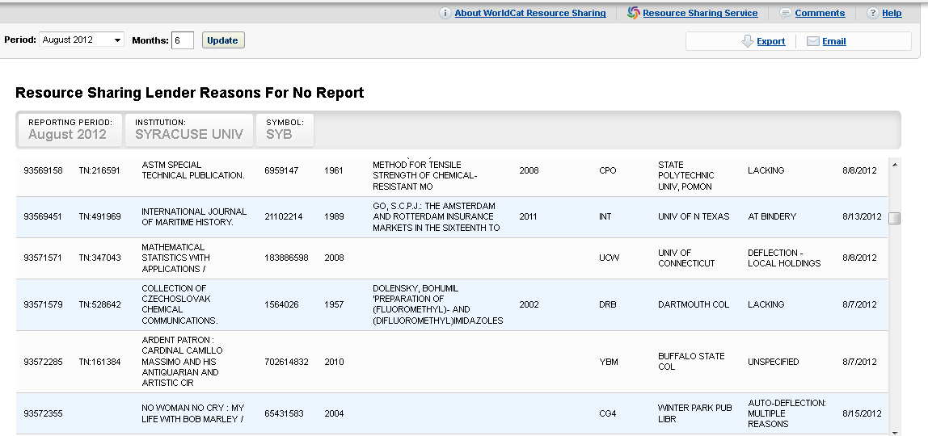
Lender Reasons for No Report

Slide 42
Stats
Assess reciprocity reports—is there an institution that you should contact to see if you can get a reciprocal agreement?
Assess existing reciprocal agreements for effectiveness and fairness—build the relationship and adjust your custom holdings accordingly.

Slide 43
Other reports from
Monthly IFM reports:
Can be emailed to you.
Good way to check who is charging you who shouldn’t—and I’m always surprised by this.

Slide 44
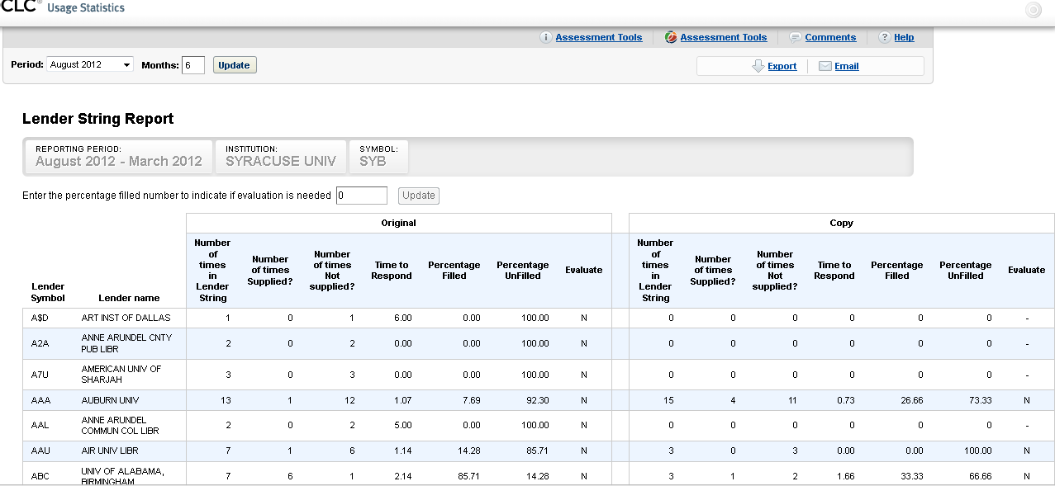
Using OCLC report to Refine Custom Holdings
Notes:
Remove slow and low percentage filling libraries from custom holdings profiles.

Slide 45
Custom Searching—Why and How
Why
Target types of transactions or actions to help your ILL run smoothly.
Use ILLiad fields strategically to monitor your addresses, users, or requests and proactively clean up problems.

Slide 46
What can you search?
Pretty much anything in the ILLiad database
User information
Lender Address fields
Transaction data
User activity
Movement between one queue to another.

Slide 47
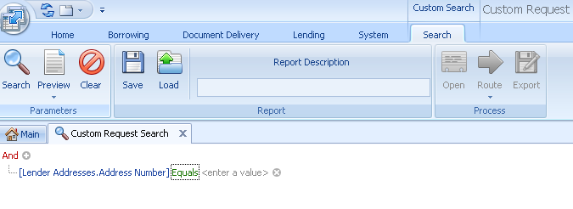
How to Search
Select the fields you want to search in the selected table
Lenders
Users
Transactions

Slide 48
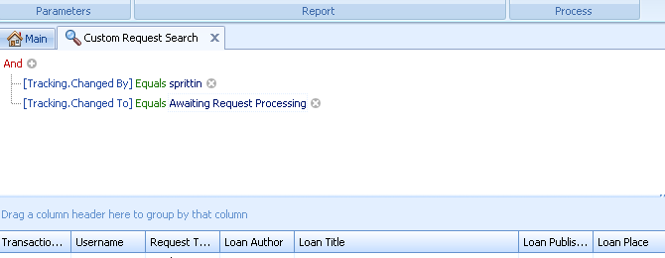
Improved Operations Search— Open and Close (not finish)
Find out how many times staff are opening and closing requests without finishing or routing request
Look at transactions and train staff using these transactions.

Slide 49
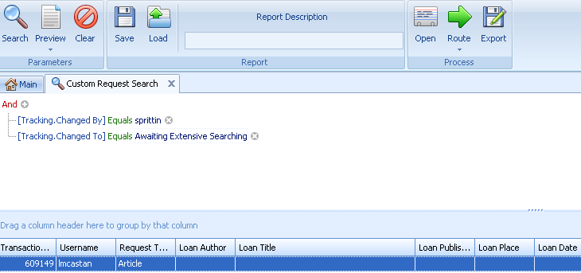
Queue escalation
See how often staff are routing to extensive queues—use these transactions to train with.

Slide 50
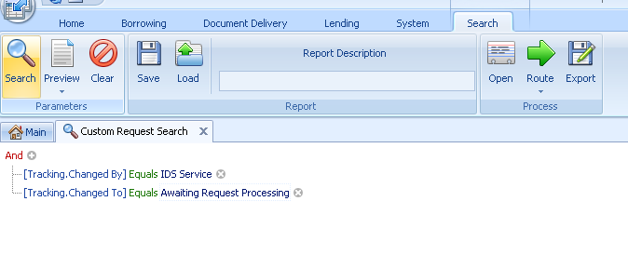
Tracking how systems are working
Look at transactions to see what movement would be useful to you.
Question—what ideas do you have for using this at your shop?

Slide 51
Using Fields for Maintenance
What do you want to monitor in ILLiad that ILLiad doesn’t have a built in maintenance system?
SU example—lender addresses—which ones do we need to check and setting up a plan to maintain the database.

Slide 52
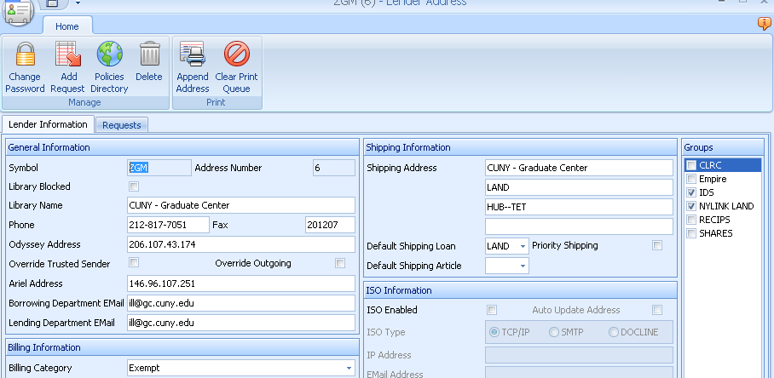
Picking the right field
At SYB, we used the fax field and number code to indicate when the address was last updated.

Slide 53
There’s always a better search out there.
Who has a custom search that you’re proud of or has been especially useful?
How does it help you and how can it help others?

Slide 54
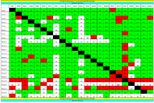
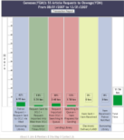
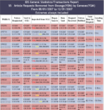
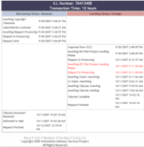
Transaction Performance Analysis Module (TPAM)
Notes:
TIM
TPAM provides libraries with a series of hierarchically linked charts.

Slide 56
Project Overview Chart
Borrowing Library : 10
Lending Library: 13
18.1 hours for 5 Article(s)

Slide 57
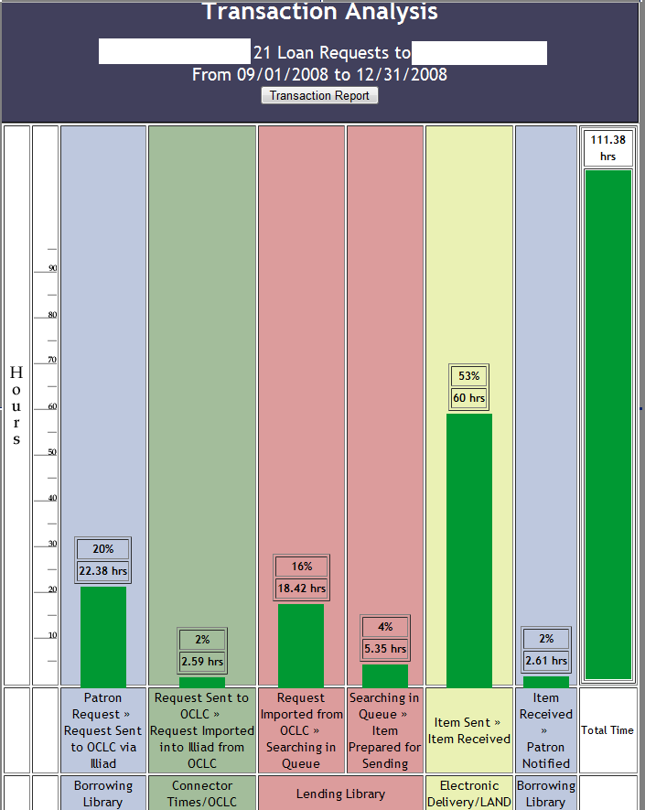
Courier / Mail
Physical Delivery
Direct
Request?
Searching Catalog, Retrieval, Staffing ?

Slide 58
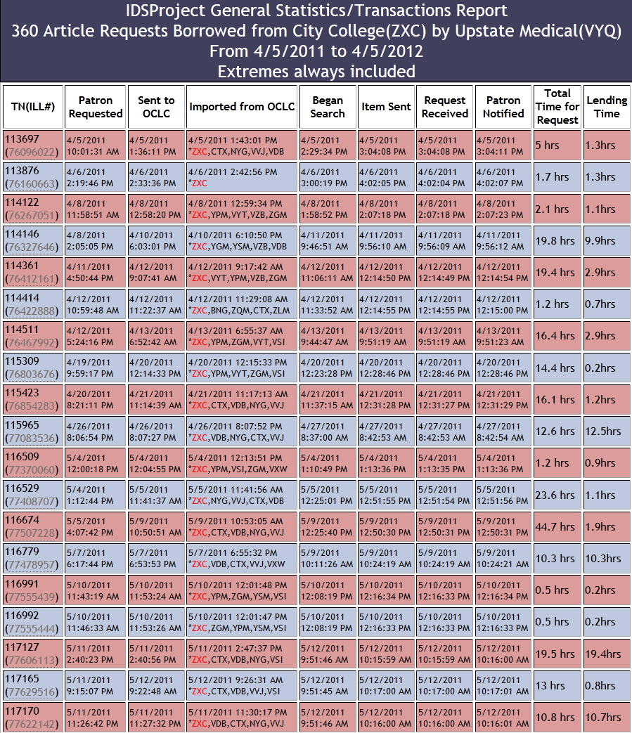

Slide 59
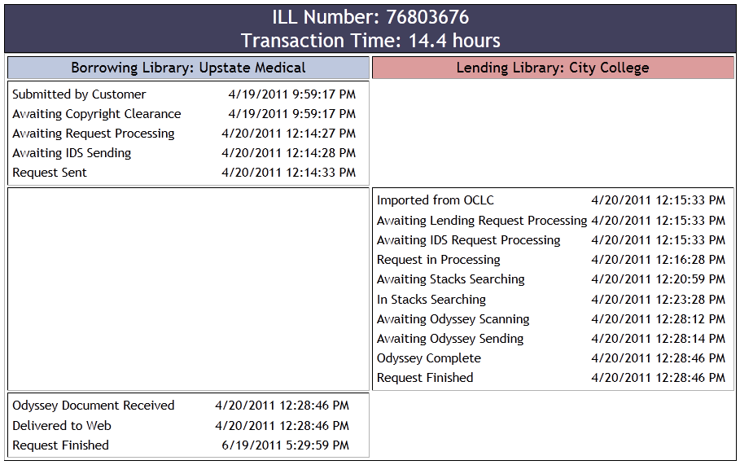
Tracking History
Notes:
Unique and important view two-way perspective of each ILL transaction. No other system looks across the entire process with such detail and ease.

Slide 60
Hands-On Activity
Regional User Groups
Identify one activity or function that you want to track
What data might be available to identify this?
What tools do you or might you use to track this activity?

